Slide 1
Medical API Resources

Slide 2
Clinical Trails.gov
Association of National Library of Medicine
Information regarding New studies & old studies are up to date.
ClinicalTrials.gov currently lists 221,361 studies with locations in all 50 States and in 192 countries.
API URL:
https://clinicaltrials.gov/ct2/about-site/link-to
Example :
https://clinicaltrials.gov/search?cond=heart+attack

Slide 3
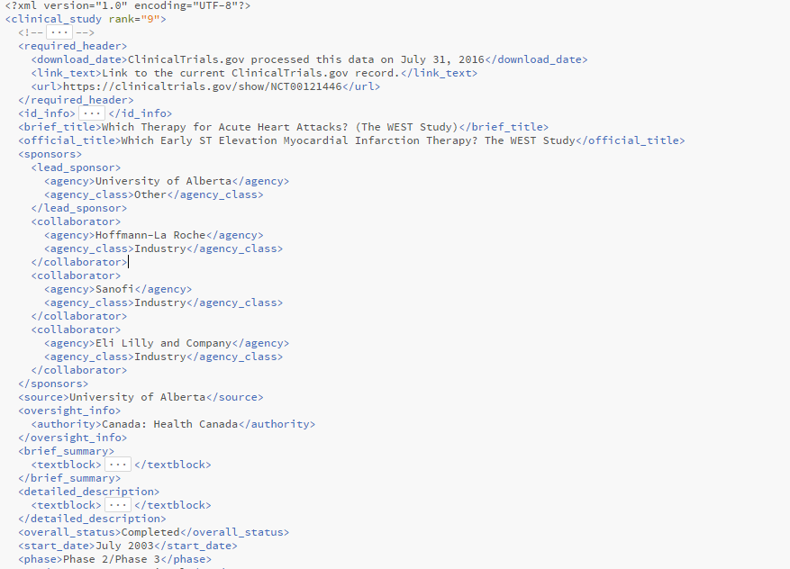
XML result :

Slide 4
Healthdata.gov
This API provides the information related
Health
Quality
Medicare
Hospital
Inpatient
National
State
API URL:
https://data.healthcare.gov/browse?sortBy=most_accessed&utf8=%E2%9C%93
EXAMPLE :
https://chhs.data.ca.gov/api/views/x4kp-ag8p/rows.json?accessType=DOWNLOAD

Slide 5
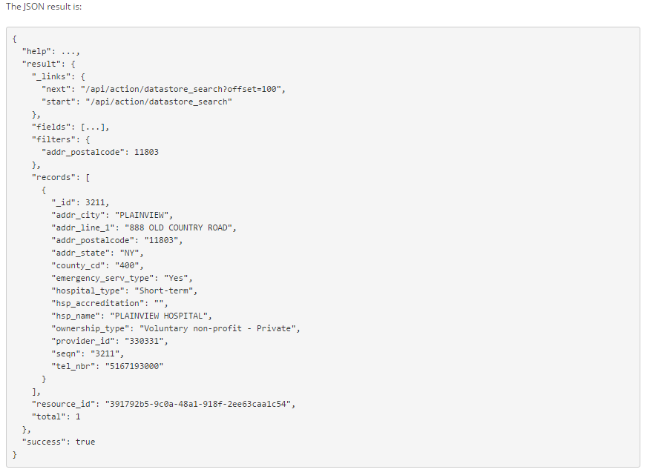

Slide 6
HealthCare.gov
HeathCare.gov provides information on health care and health insurance options in the United States.
Starting October 1, 2013, users will be able to fill out applications and view a custom list of health care plan options.
API URL :
https://www.healthcare.gov/
Example URL :
https://www.healthcare.gov/api/index.json

Slide 7
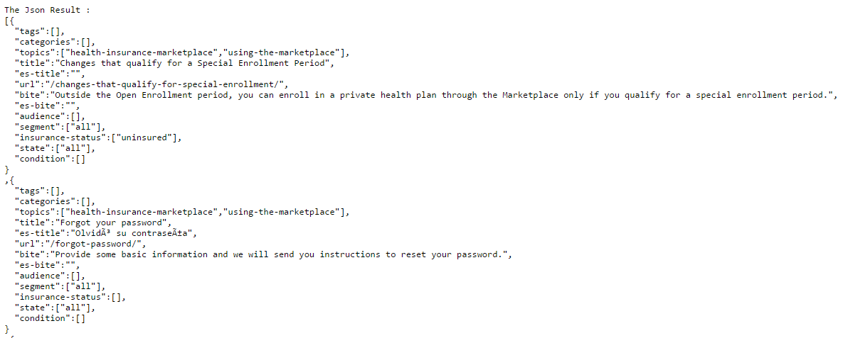

Slide 8
MedlinePlus Connect
It Provides the complete information regarding
Problem Codes(SNOMED CT, ICD-9-CM, ICD-10-CM).
Medication Codes(RXCUI, NDC)
Lab Test Codes(LOINC)
API URL :
http://www.programmableweb.com/api/medlineplus-connect
Example Url:
https://apps.nlm.nih.gov/medlineplus/services/servicedemo.cfm?mainSearchCriteria.v.c=410.12&mainSearchCriteria.v.cs=2.16.840.1.113883.6.103&mainSearchCriteria.v.dn=&informationRecipient.languageCode.c=en&knowledgeResponseType=text/xml

Slide 9
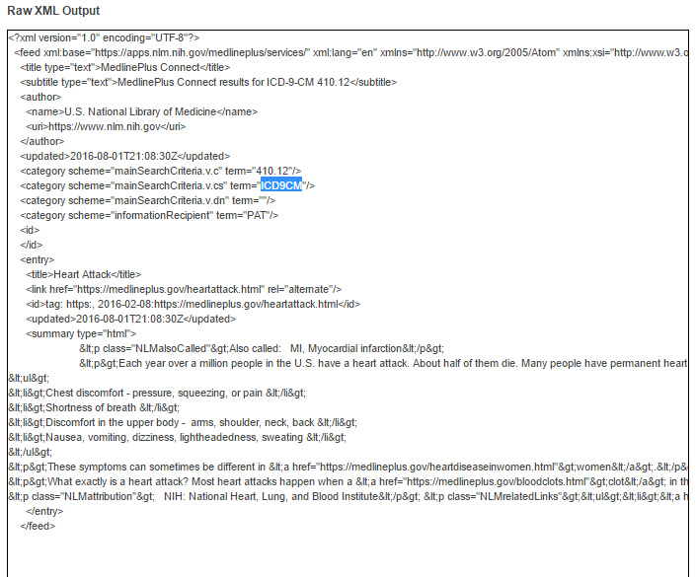

Slide 10
Blue Button Connector
Provides the Basic Contact Information & NPI of the provider
Based on the
State
ZIP
Name
Organizations Information
API URL :
http://api.bluebuttonconnector.healthit.gov/
Example :
http://api.bluebuttonconnector.healthit.gov/stage2?name=ABADIER%2C%20RAFIK&limit=30&offset=0

Slide 11
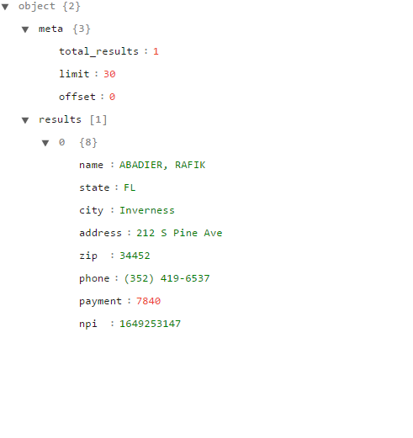
The json result

Slide 12
HRSA Data Warehouse
Health Centre Data(health care centres based on the location)
Infant Mortality Data
Ryan White HIV/AIDS Medical Care Providers
API URL:
http://datawarehouse.hrsa.gov/data/dataServices/developerGuide.aspx
Example :
http://datawarehouse.hrsa.gov/data/dataServices/developerGuide.aspx#HealthCenterDataSampleResult

Slide 13
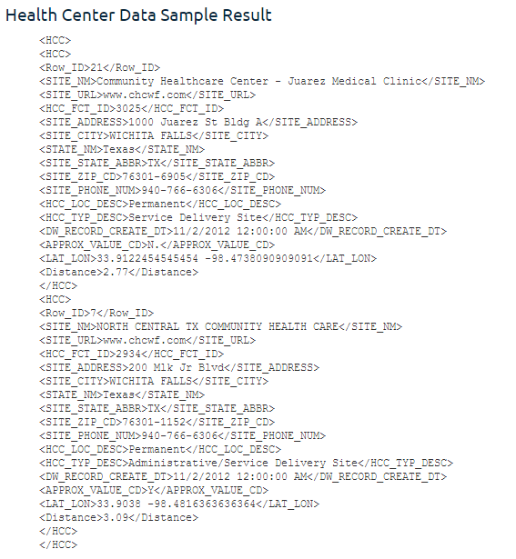

Slide 14
National Practitioner Data Bank
Medical Malpractice Payers
State HealthCare Practitioners Licensing & Certifications Authorities
Hospitals
Federal & Government Agencies
API URL:
https://www.npdb.hrsa.gov/software/downloadsAndDocumentation.jsp
Example:
https://www.npdb.hrsa.gov/software/QRXSWebServiceUserGuide.pdf
Find the example in the user guide

Slide 15
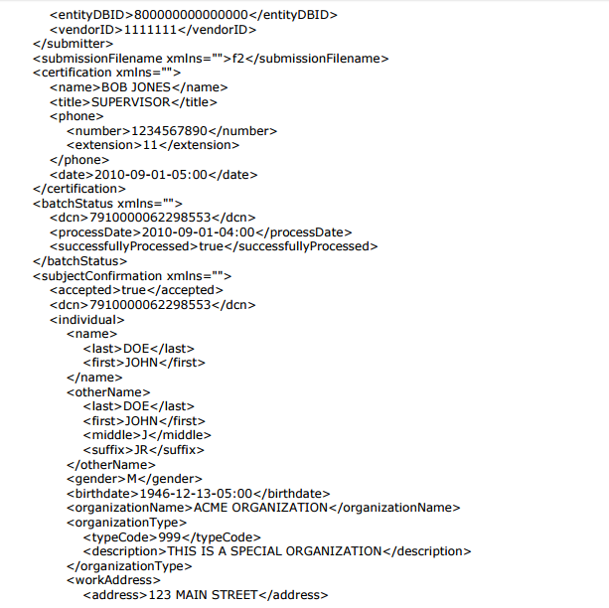
Xml Result :
Cntd…

Slide 16
